Slide 1

Face Recognition Project
User Manual
Author: Arjun Mohunta
Notes:
Preworks course home assignments

Slide 2
Table of Contents
Acknowledgements
About me
My Journey
About the App
How to use the App
Option name
Contact person

Slide 3
Acknowledgements
A small vote of thanks for all who have helped you in this journey of App Development – your parents, Mentors,Mr. Ken, Group Members, Friends, Sites etc.

Slide 4
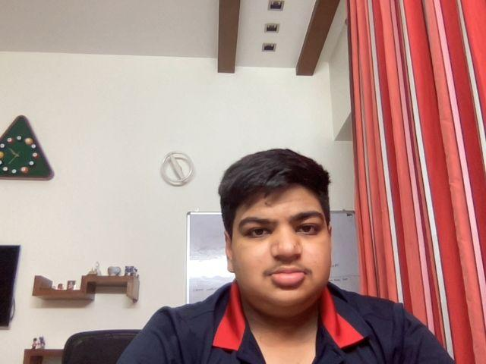
About Me..
My name is Arjun Mohunta.I am in grade 11.I have worked on making an app that could recognize your face and which would be very useful in daily life

Slide 5
About My Internship Journey with Clevered..
My internship with clevered has been very exciting and the teachers have been helpful and guided me throughout with my project by giving valuable feedback.I have also learnt a lot from this internship.

Slide 6
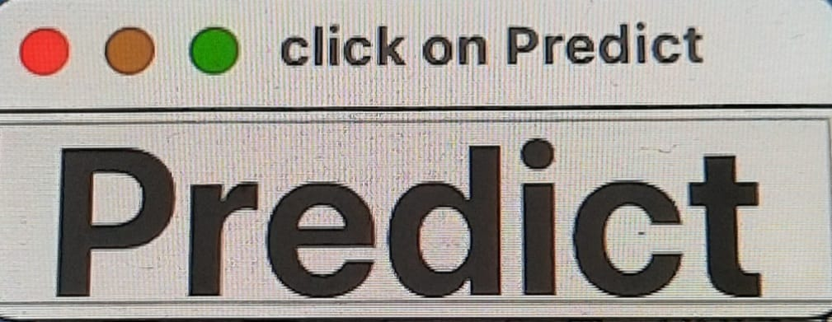
About App..
This app would recognize your face and would give you a prompt if the face has not been found.The app is very user friendly and you only have to click the predict button to match your face.

Slide 7
How do I use the App?

Slide 8
Predict Button
To start the project you would see a page to check the image.To match the image you would have to click the predict button to match the face.

Slide 9
Contact Person
For any issues or feedback please feel free to reach out to Arjun Mohunta on the email arjunmohunta@gmail.com .

Slide 10
Thank you!

